Slide 1

Automation Testing
By- Manas

Slide 2
PAGE OBJECT MODEL
Sometimes we need to work on the same elements for multiple times (For both Business operations and Validations). In that case we need to identify the same elements again and again manually. In that case instead of identify the elements manually by every team member, one senior resource in a project will be involving to identify the elements with unique locators and rest of the team members can access the objects whenever they required.

Slide 3
We can implement Page Objects in 2 different ways:
1. By using By class
2. By using @findBy (Accessing through PageFactory Concept)
Note: In real time we are handling page objects with pagefactory method only.

Slide 4
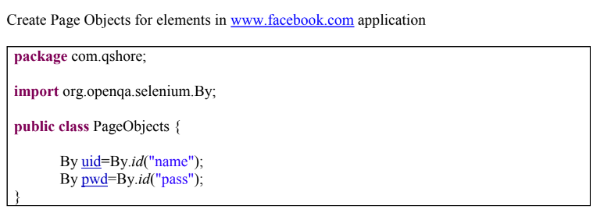
1. By Class
By Class: In this method we are creating objects with By class. By importing class into another class, we can access these objects.

Slide 5
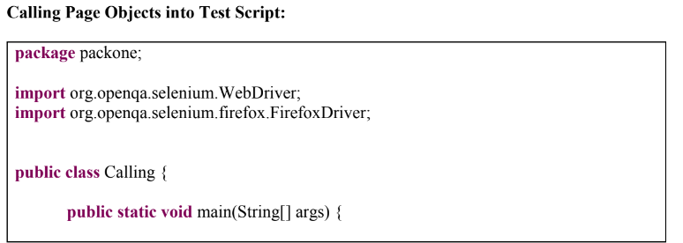
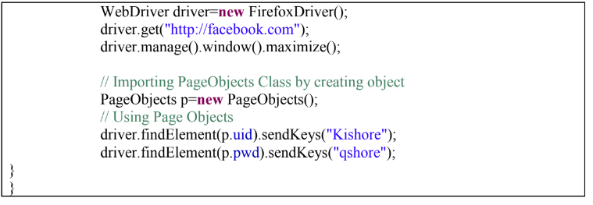

Slide 6
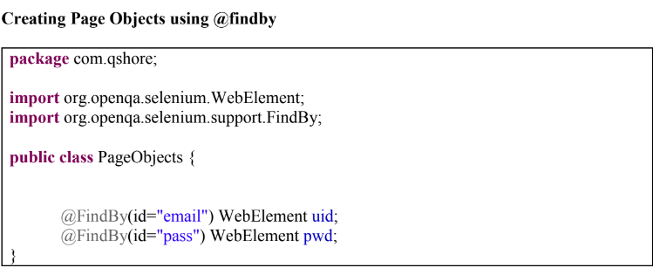
2. @findby annotation
@findby : In this we are creating objects with @findby. We can use these objects in another class by using “PageFactory” concept.

Slide 7
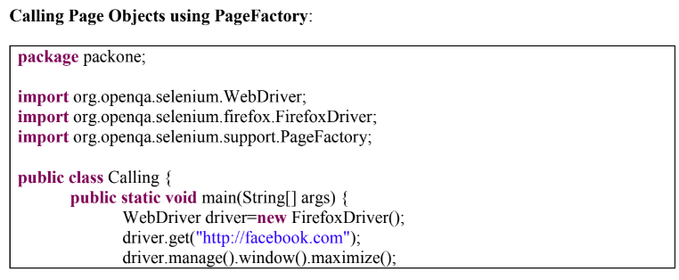
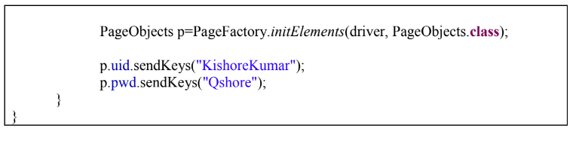

Slide 8
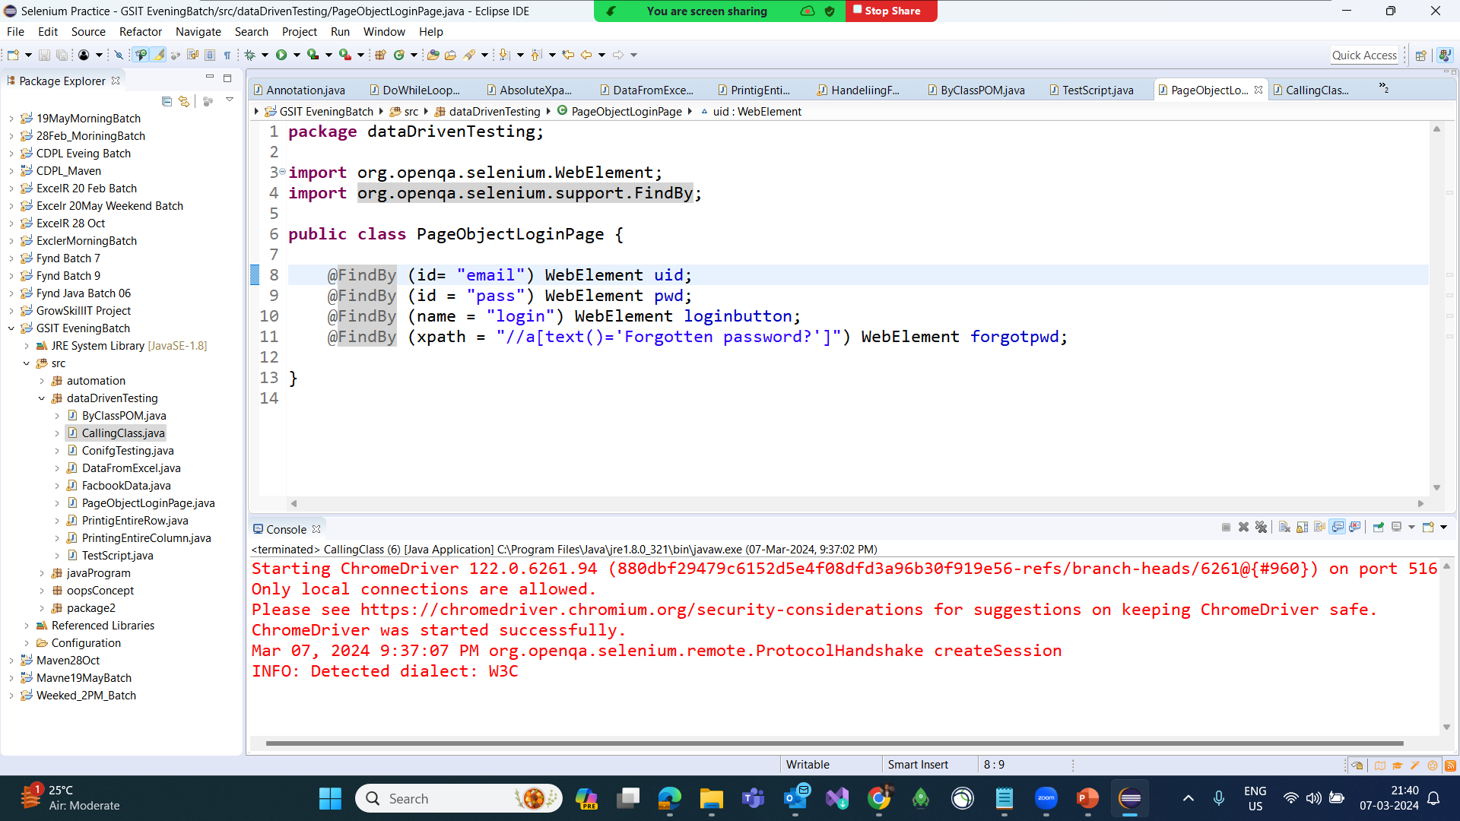

Slide 9
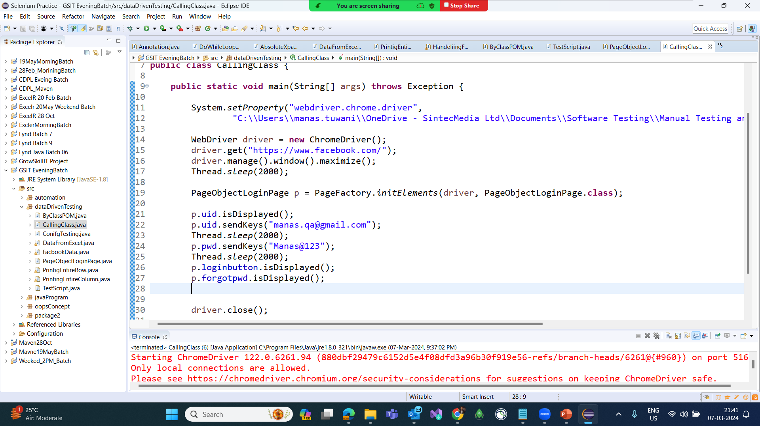

Slide 10
